Slide 1
jQuery Begins
Lesson 4.1

Slide 2
PreClass Drill
jQuery $(Begins)

Slide 3
JavaScript – max (15 mins)
PseudoCode it first – DON’T GOOGLE THE ANSWER
Write a function that takes in two numbers and outputs the max (the greater of the two numbers).
Ex: Input: 1, 2
Output: 2
Ex: Input: 6, -4
Output: 6
Ex: Input: 3.4, 2
Output: 3.4
(Hint…)
var max = function(num1, num2){
If (…) { return … } else {return .. }
}

Slide 4
JavaScript Max Answer (5 mins)
Did you find a solution?
Does it look a little like this…
var max = function(num1, num2) {
if (num1 > num2) { return num1; }
else { return num2; }
}

Slide 5
Admin Items
jQuery $(Begins)

Slide 6

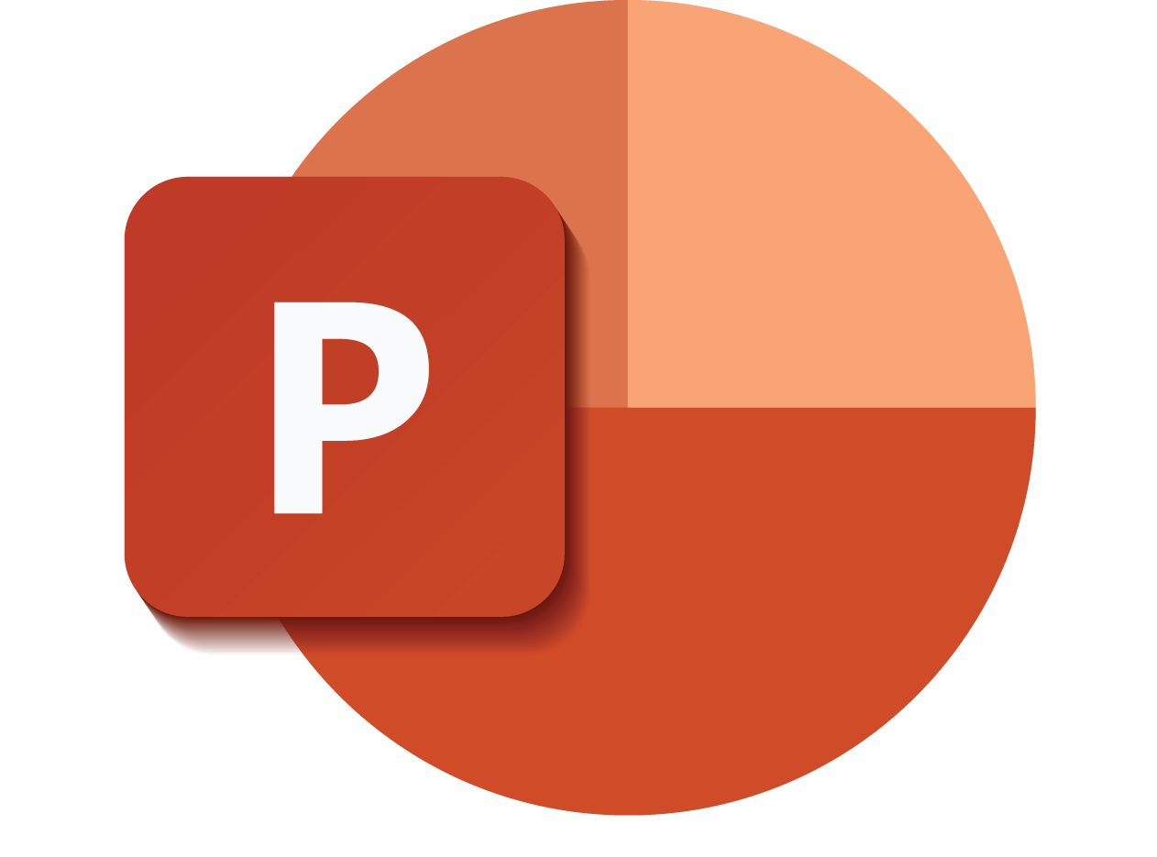
Death by PowerPoint: Not the Way to Learn Coding
jQuery $(Begins)
Notes:
Image from: shutterstock_470084681

Slide 7

True Way to Learn Coding
jQuery $(Begins)
Notes:
Image from: shutterstock_589180820

Slide 8
Be prepared to have classes that are increasingly “just code.”
(You will appreciate it in the long run.)
jQuery $(Begins)

Slide 9
Today’s Class
jQuery $(Begins)

Slide 10


Agenda
In today’s class we’ll be covering:
DOM manipulation using plain JavaScript
DOM manipulation using jQuery
Responding to click events
jQuery $(Begins)

Slide 11
DOM Manipulation
jQuery $(Begins)

Slide 12
Understanding the DOM
Basic Example: http://todomvc.com/examples/vanillajs/
Every HTML page begins as static content.
However, with Javascript/jQuery, we can modify the DOM and change this static content in real time.
This allows us to build dynamic sites.
jQuery $(Begins)

Slide 13
DOM Manipulation with Plain JavaScript
jQuery $(Begins)

Slide 14
DOM Manipulation (Instructor: 15 mins)
http://todomvc.com/examples/vanillajs/
/04-jquery/01-Activities/01-DOM_Manipulation/1.html

Slide 15
15 minutes
Activity: Generating HTML with Plain JavaScript
jQuery $(Begins)

Slide 16

Activity: Generating HTML with Plain JavaScript (15 mins)
Suggested Time: 15 minutes
Using the file sent to you as a starting point, add the missing code so that your JavaScript generates HTML content that displays all drink options.
Hint: You will need a for loop. Inside the for loop, you will need to use each of the following methods: createElement, textContent, and appendChild.
/04-jquery/01-Activities/02-JSDrinkList/Unsolved/drinklist-unsolved.html
BONUS: Instead of using a for loop, try searching about the use of the jQuery .each method.
jQuery $(Begins)

Slide 17
Instructor Review: 7 mins
Suggested Time: 7 minutes
file:///Users/greg/Dropbox/git/RICHRIC201905FSF2/04-jquery/01-Activities/02-JSDrinkList/Solved/drinklist-solved.html
jQuery $(Begins)

Slide 18
Intro to jQuery
jQuery $(Begins)

Slide 19

Intro to jQuery: (Instructor: 10 mins)
jquery.com
jQuery is a cross-platform JavaScript library designed to simplify client-side HTML scripting.
(DOM Tree Surgery)
jQuery $(Begins)
Notes:
shutterstock_206072047

Slide 20
Query Helper Library
jQuery can be useful for tasks such as:
Dynamically inserting, updating, or removing HTML
Registering click or other change events
Animating HTML elements
Downloading data from databases
And much more!
jQuery $(Begins)

Slide 21
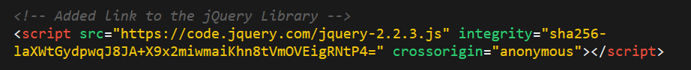
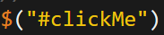
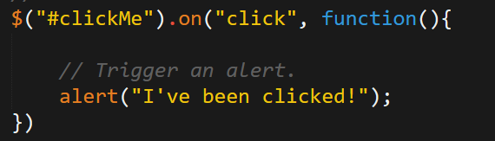
Working with jQuery
01
Include a CDN (Content Delivery Network) link to the jQuery script.
02
Utilize the jQuery specific ($) selector.
03
Apply jQuery methods on the selected elements.
jQuery $(Begins)

Slide 22
DOM Manipulation with jQuery
jQuery $(Begins)

Slide 23
Three Progressively Complex Examples (Ins: 10 mins)
/04-jquery/01-Activities/03-jQueryGenerators/1.html
/04-jquery/01-Activities/03-jQueryGenerators/2.html
/04-jquery/01-Activities/03-jQueryGenerators/3.html

Slide 24
Activity: Generating HTML with jQuery
15 minutes
jQuery $(Begins)

Slide 25
Activity: Generating HTML with jQuery (15 Minutes)
Suggested Time: 15 minutes
Refactor (rewrite) your previous drinkList code from earlier, but this time use jQuery to complete all of the same tasks.
Your final code should NOT have any of the following methods: createElement, innerHTML, or appendChild.
Hint: Don’t forget to “incorporate” jQuery before you begin.
Bonus: Instead of using a for loop, look up how to use the jQuery .each method.
/04-jquery/01-Activities/04-jQueryDrinkList/Unsolved/jquery-drinklist-unsolved.html
jQuery $(Begins)

Slide 26
Review Activity (5 minutes)
/04-jquery/01-Activities/04-jQueryDrinkList/Solved/jquery-drink-list-solved.html
jQuery $(Begins)

Slide 27
15 Minutes

Slide 28
On-Click Basic
jQuery $(Begins)

Slide 29
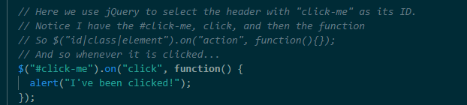
OnClick Example (Instructor: 7 mins)
/04-jquery/01-Activities/05-OnClickBasic/onclick.html
The code has a jQuery selector to select the html element (button, header, anything)
It then has a .on('click', function(){}) syntax for capturing the event.
Inside that event's function is the code that results from the click.
Don’t be confused by the syntax. We’ll to use it for now…
and it will make more sense over time as we learn other concepts.

Slide 30
Partner Activity: Sandwich Clicking
20 minutes
jQuery $(Begins)

Slide 31
Partner Activity: Sandwich Clicking
Suggested Time: 20 minutes
Add the missing code so that clicking any of the sandwiches causes:
An alert message that says something snarky about the sandwich type.
An alert message that displays how many of a specific sandwich the user has eaten.
Hint: You will need counter variables.
Bonus: Add an image to the image-div on the click event.
/06-SandwichClick/Unsolved/sandwich-click-unsolved.html
jQuery $(Begins)

Slide 32
Review Activity
jQuery $(Begins)

Slide 33
Sandwich Clicking Answers: Instructor: 5 mins
Notice the Counter Variables
The on-click events are tied to each of the sandwich headers.
The on-click events trigger the counter to go up and creates the alerts
file:///Users/greg/Dropbox/git/RICHRIC201905FSF2/04-jquery/01-Activities/06-SandwichClick/Solved/sandwich-click-solved.html

Slide 34
Sandwich Clicking Bonus: Instructor: 5 mins
Notice images can be added.
Note that we are injecting HTML with the src pointing to the jpg.
file:///Users/greg/Dropbox/git/RICHRIC201905FSF2/04-jquery/01-Activities/06-SandwichClick/Solved/sandwich-click-solved-bonus.html

Slide 35
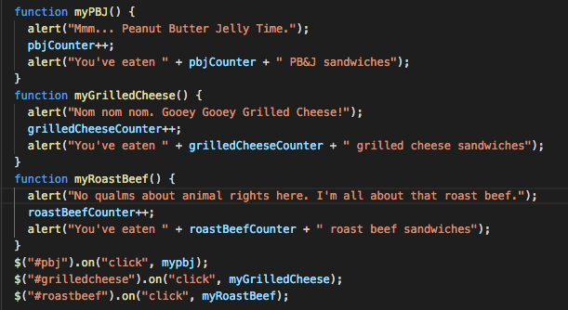
Greg’s Method…
Sometimes it’s easier to split the method and the onClick definition…
file:///Users/greg/Dropbox/git/RICHRIC201905FSF2/04-jquery/01-Activities/06-SandwichClick/Solved/sandwich-click-solved-bonus.html

Slide 36
Partner Activity: Trigger Random
12 minutes
jQuery $(Begins)

Slide 37
Partner Activity: Trigger Random (12 minutes)
Suggested Time: 12 minutes
Add the missing code so that clicking the big blue button triggers a random number (between 1 and 1,000) to be selected and prominently displayed in the randomNumber div.
/04-jquery/01-Activities/07-TriggerRandom/Unsolved/trigger-random-unsolved.html
jQuery $(Begins)

Slide 38
Review Activity
jQuery $(Begins)

Slide 39
Review Trigger Random (5 mins)
We latched onto the random-button using its ID. Let them know where to focus their attention: Not the classes, and not the spans. The ID is what mattered in this case.

Slide 40
Review Trigger Random (5 mins)
We then created a click event tied to this random-button. This event triggers a random number between 1 and 1000 to be generated and printed to the HTML.

Slide 41
Partner Activity: Lottery Generator
20 minutes
jQuery $(Begins)

Slide 42
Partner Activity: Lottery Generator (20 minutes)
Suggested Time: 20 minutes
Use the code from the previous random number generator to create a lottery generator.
The lottery generator should select 9 random numbers (and always 9 numbers). Example: 886563264
Display this number in the randomNumber div.
When the user clicks again, create a new row with the most recent number at the top.
/04-jquery/01-Activities/08-LotteryGenerator/README.md
jQuery $(Begins)

Slide 43
Review Activity
jQuery $(Begins)

Slide 44
Instructor Review: (5 mins)
We needed to create a for loop that created 9 different numbers. Without this for loop, we couldn't guarantee that we'd have 9 numbers. Also point out that we are using prepend as opposed to append so that the newest number shows up at the top.

Slide 45
HOMEWORK #3 JavaScript Psychic Guess / Hangman Due Tuesday, June 4th @ 11:59PM

Slide 46
TA: Intro to Homework #4 Crystals Collector Game Due Tuesday, June 11 @ 11:59pm https://www.youtube.com/watch?v=yNI0l2FMeCk&feature=youtu.be

Slide 47
That’s All
Now: Office Hours!

Slide 48
Challenge: Number Checker
20 minutes
jQuery $(Begins)

Slide 49
Challenge: Number Checker
Suggested Time: 20 minutes
Based on the demonstration, create an application in which:
A computer selects a random number between 1 and 4.
The user clicks buttons numbered 1 to 4.
If the user’s number matches the computer’s number, display text informing them of this in the Result panel. Otherwise, display text informing them that they lost.
Bonus: If you finish early, try to improve the aesthetics of your app.
jQuery $(Begins)

Slide 50
Questions?
jQuery $(Begins)

